Slide 1
Agenda for Module 2: Algorithms
Part 1:
Data Structures
Part 2:
Search Algorithms
Time Complexity
Sorting Algorithms
Part 3:
Graph Algorithms
Overview of Algorithmic Techniques

Slide 2

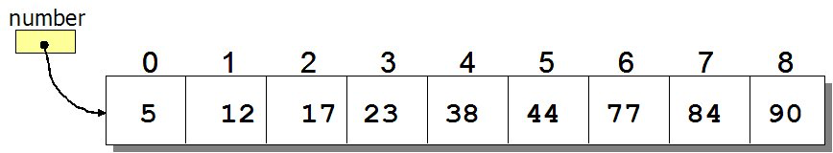
Search Algorithms
How to search for an element in a list?
Sequential search: Go through each element and check if it is the required element
Best case?
Worst case?
Source: http://www.spinachandyoga.com/how-to-deal-with-a-long-to-do-list-with-zen/
Source: http://www.csit.parkland.edu/~mbrandyberry/CS1Java/Lessons/Lesson27/BinarySearch.htm

Slide 3
Evaluating Algorithms
How do we know whether one algorithm is better than another?
for i = 0 to n
a = 1
for i = 0 to n
for j = 0 to n
a = 1
Which one runs faster?
Notes:
One way we determine whether an algorithm is better than another is by seeing how fast the algorithm runs.
Note to self – ask them which one runs faster, maybe set up a poll

Slide 4
Time-Complexity: Upper Bound O-notation
for i = 0 to n
a = 1
for i = 0 to n
for j = 0 to n
a = 1
O(n)
O(n²)
Algorithm X executes in 10n² + n / 3.7 + 22 steps → O(n²)
Algorithm Y executes in 100n log n + 14n + 22 steps → O(n log n)
Which algorithm runs faster?
Algorithm Y
Notes:
Explain Big O notation – worst case running time of an algorithm. There are other ways of measuring time complexity, but we don't cover them here
Explain how time complexity is dominated by the largest term, which simplifies time complexity estimation

Slide 5
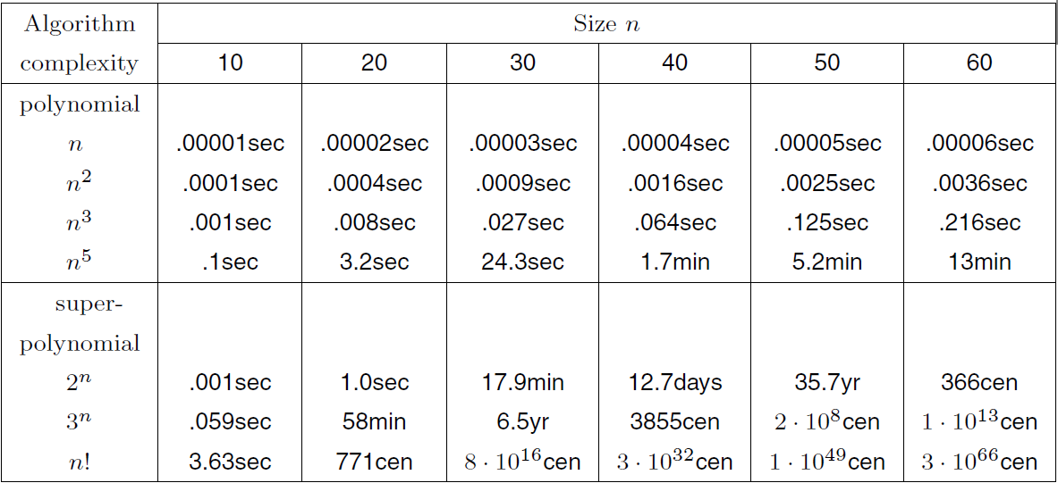
Running Time Comparison
Notes:
Why is this important?

Slide 6
Running Time Comparison

Slide 7
Running Time Comparison

Slide 8
Running Time Comparison
Good
Bad!
Notes:
Note – time complexity lets us characterize of how fast an algorithm can run, with the larger time complexity being worse for running time.

Slide 9
Search Algorithms
How to search for an element x in a list?
Sequential search: Go through each element and check if it is the the required element
Best case?
Worst case?
What if the list is sorted?
Can we do better?
YES
BINARY SEARCH
Source: http://www.spinachandyoga.com/how-to-deal-with-a-long-to-do-list-with-zen/

Slide 10

Binary Search Problem
Problem: You are looking for your school locker, which is number 151. At one end of the hallway, the lockers start at 100, and they end on 199 on the other side of the hallway.
What is the best way to search for your locker?
Notes:
You should also set up a poll question for this.

Slide 11
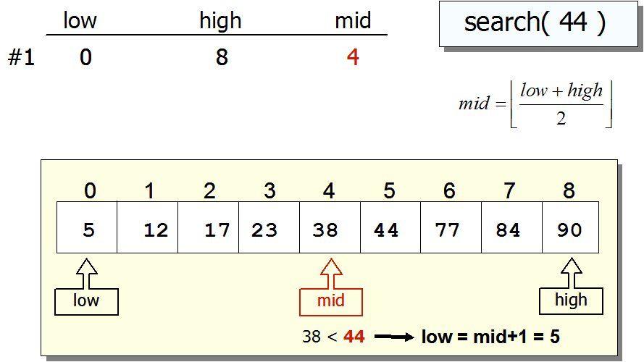
Search Algorithms: Binary Search
If list is sorted:
Split list into two halves. If x is greater than element in the middle, then discard the left half. Otherwise discard the right half. Repeat until you find x.
Source: http://www.csit.parkland.edu/~mbrandyberry/CS1Java/Lessons/Lesson27/BinarySearch.htm

Slide 12
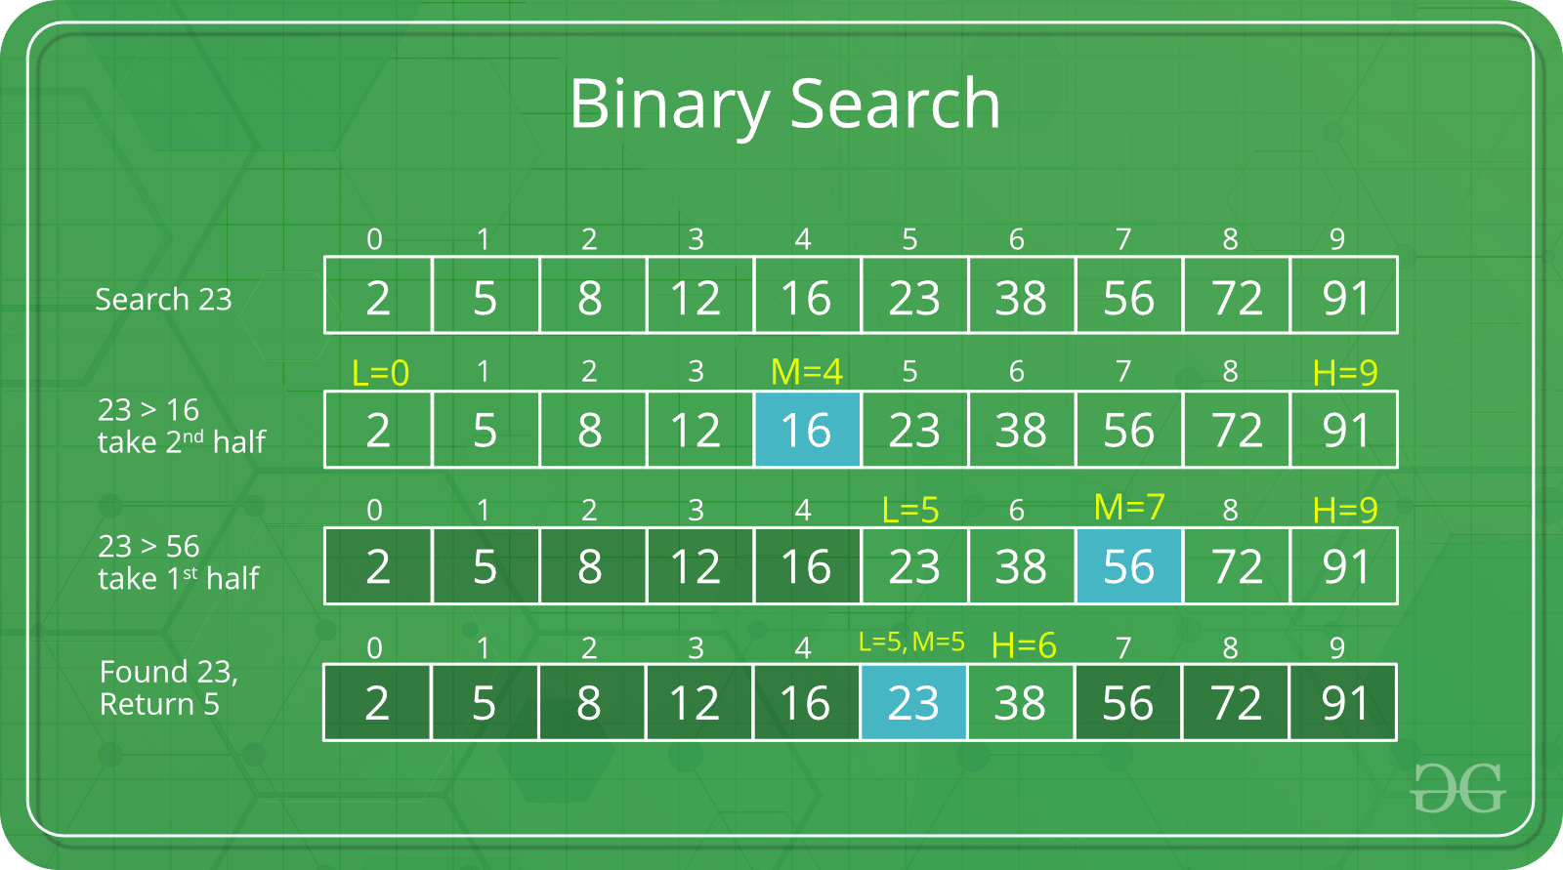
Search Algorithms: Binary Search
If list is sorted:
Split list into two halves. If x is greater than element in the middle, then discard the left half. Otherwise discard the right half. Repeat until you find x.
Sourcehttps://www.geeksforgeeks.org/binary-search/

Slide 13
Search Algorithms: Binary Search
If list is sorted:
Split list into two halves. If x is greater than element in the middle, then discard the left half. Otherwise discard the right half. Repeat until you find x.
Sourcehttps://www.geeksforgeeks.org/binary-search/

Slide 14
Search Algorithms: Binary Search
If list is sorted:
Split list into two halves. If x is greater than element in the middle, then discard the left half. Otherwise discard the right half. Repeat until you find x.
Sourcehttps://www.geeksforgeeks.org/binary-search/

Slide 15
Search Algorithms: Binary Search
If list is sorted:
Split list into two halves. If x is greater than element in the middle, then discard the left half. Otherwise discard the right half. Repeat until you find x.
Sourcehttps://www.geeksforgeeks.org/binary-search/

Slide 16
Search Algorithms: Binary Search
Running time?
First, consider sequential search:
How many elements remain after each iteration?
10, 9, 8, 7 … 1 -> ( O(n) )

Slide 17
Search Algorithms: Binary Search
Running time?
First, consider sequential search:
How many elements remain after each iteration?
10, 9, 8, 7 … 1 -> ( O(10) )
Now consider binary search:
How many elements remain after each iteration?
10, 5, 2, 1 -> ( O(4) )

Slide 18
Search Algorithms: Binary Search
Running time?
First, consider sequential search:
How many elements remain after each iteration?
10, 9, 8, 7 … 1 -> ( O(10) )
Now consider binary search:
How many elements remain after each iteration?
10, 5, 2, 1 -> ( O(4) )
What if we had 20 elements?
20, 10, 5, 2, 1 -> ( O(5) )

Slide 19
Search Algorithms: Binary Search
Running time?
First, consider sequential search:
How many elements remain after each iteration?
10, 9, 8, 7 … 1 -> ( O(10) )
Now consider binary search:
How many elements remain after each iteration?
10, 5, 2, 1 -> ( O(4) )
What if we had 20 elements?
20, 10, 5, 2, 1 -> ( O(5) )
Every iteration we cut the list down in half ( N, N/2, N/4 … 1 )
So it is log(n) time!
Notes:
Question for Brian – under what conditions would you want to sort a list first and then perform searching

Slide 20

Exercise: Binary Search
LeetCode 704 – Binary Search[Easy]
Binary Search – LeetCode
Optional - LeetCode 700 – Search in a BST [Easy]
Search in a Binary Search Tree - LeetCode
Notes:
Example of binary search tree, which shows how our choice of data structure can make our search operations easier

Slide 21
Sorting Algorithms
Sorting algorithm is an algorithm that puts elements of a list in a certain order
Sorting is a fundamental operation in computer science and algorithms
Many algorithms use it as an intermediate step
There are several sorting algorithms, differing in their efficiency.

Slide 22
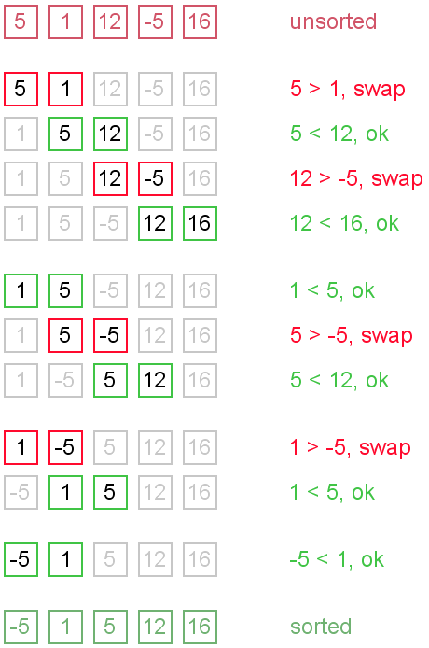

Bubble Sort
Go through the list:
If the next element is smaller:
SWAP!
Notes:
Largest bubble rises to the water’s surface first, then smaller bubbles

Slide 23
Bubble Sort
Go through the list:
If the next element is smaller:
SWAP!
Notes:
Largest bubble rises to the water’s surface first, then smaller bubbles

Slide 24
Bubble Sort
Go through the list:
If the next element is smaller:
SWAP!
Notes:
Largest bubble rises to the water’s surface first, then smaller bubbles

Slide 25
Bubble Sort
Go through the list:
If the next element is smaller:
SWAP!
Notes:
Ok, so we just finished our first pass – we moved the largest number to the end of the array

Slide 26
Bubble Sort
Go through the list:
If the next element is smaller:
SWAP!
Notes:
Largest bubble rises to the water’s surface first, then smaller bubbles

Slide 27
Bubble Sort
Go through the list:
If the next element is smaller:
SWAP!
Notes:
Largest bubble rises to the water’s surface first, then smaller bubbles

Slide 28
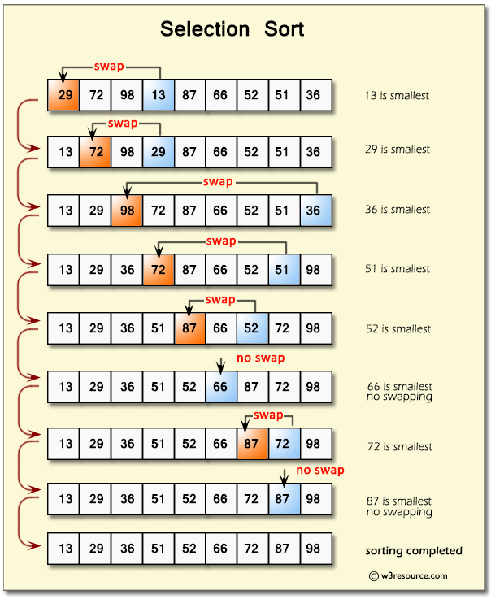
Selection Sort
In iteration i, find index of the smallest entry in unsorted part of the list
Swap a[i] and a[min]
i ← i + 1
Notes:
Bubble sort
Insertion

Slide 29
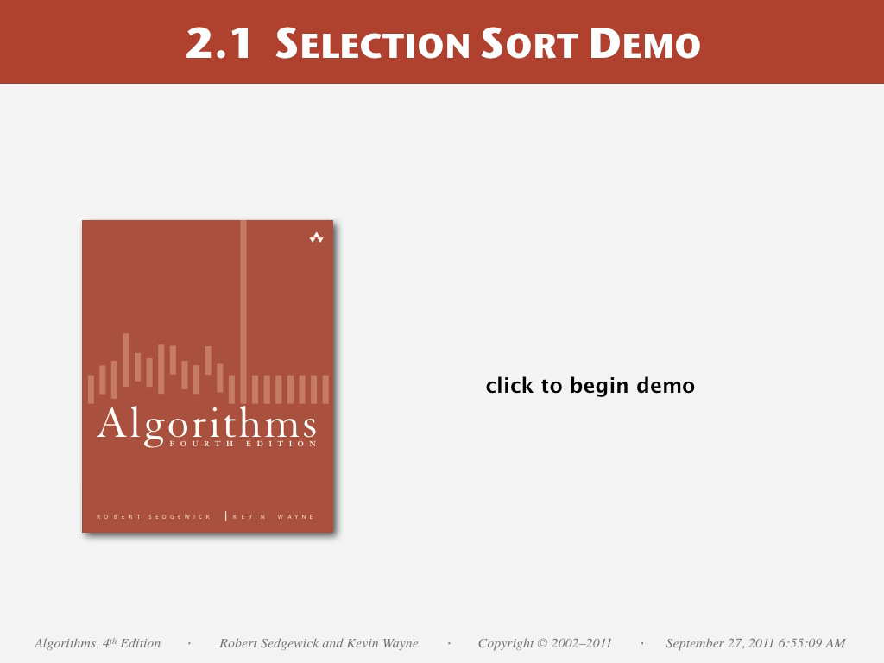

Slide 30
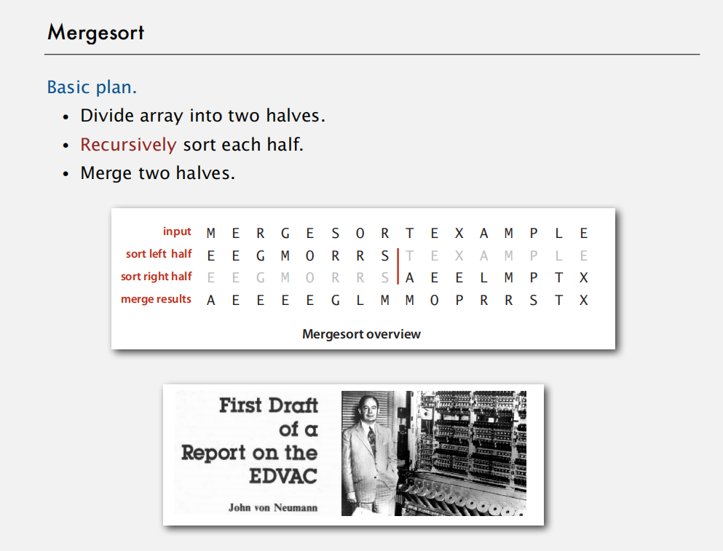

Slide 31
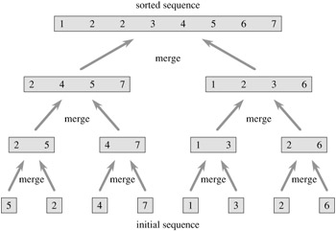
Merge Sort
Divide and conquer algorithm
Recursive algorithm
Split the list
Apply merge sort to the smaller lists
After the smaller lists are collected: MERGE
(Note that each of the sublists is already sorted)

Slide 32
Exercise: Selection Sort
LeetCode 75 – Sort Colors [Medium]
Sort Colors – LeetCode
Optional – LeetCode 912 – Sort an Array [Medium]
Sort an Array – LeetCode (Try MergeSort!)

Slide 33
Time for some exercise and discussion.
Notes:
MAKE SURE YOU HAVE PSEUDOCODE PREPARED AND MULTIPLE QUESTIONS

